Slide 1
Training Snapshot: 764 and The Com

Slide 2
How to use these slides
The following slides are a product of the DVERT Center, a national center of excellence that translates cutting edge research into actionable guidance for those at the front lines of preventing targeted violence and violent extremism.
The slides contain both presentation materials (the slides themselves) and information for the speaker (in the notes).
Anyone may use these slides for training or educational purposes.
Please do not modify, edit, adapt, or otherwise change the content of these slides.
If you have questions, notice an error, or have feedback, please contact us at dvert@cna.org.
The DVERT Center is supported by the National Institute of Justice, Office of Justice Programs, US Department of Justice under Award No. 15PNIJ-24-GK-00750-DOMR. The opinions, findings, and conclusions or recommendations expressed in this document are those of the authors, and do not necessarily reflect those of the Department of Justice.

Slide 3
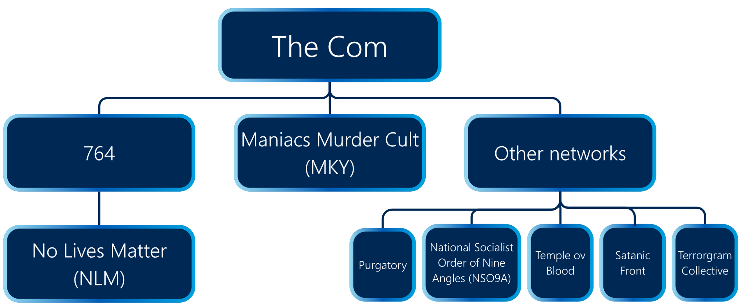
The Com
Constellation of networks and cells that engage in a variety of online and offline violent and nonviolent crimes
Source: The DVERT Center, www.dvert.org.
Notes:
The Com refers to a constellation of networks and cells that engage in a variety of online and offline violent and nonviolent crimes.
Some cells, including 764, focus on the sexual exploitation and extortion of minors, while others focus on cybercrime or offline organized crime.
On the next slide we’ll go over some of the defining features of the most well-known subsets of The Com.

Slide 4
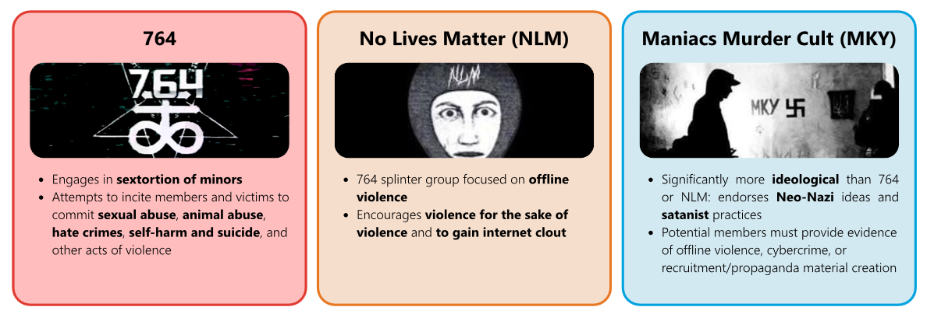
The Com
The Com is composed of many networks, including:
Source: The DVERT Center, www.dvert.org.
Notes:
764 is a network within The Com that engages in the sextortion of minors and attempts to incite both members and victims to commit sexual abuse, animal abuse, hate crimes, self-harm and suicide, and other acts of violence.
It is the most well-known network within the Com because numerous high-profile 764 perpetrators have been arrested in the US and abroad.
764 was connected to a 2025 school shooting in Nashville, Tennessee.
No Lives Matter is a 764 splinter group that focuses on offline violence.
It encourages violence for the sake of being violent as well as for online clout or status.
Participants have committed several stabbing attacks abroad.
Maniacs Murder Cult, or MKY, is another Com network with members in the US and around the world.
It is also focused on offline violence, but is more ideological than 764 or No Lives Matter.
Explicitly endorses Neo-Nazi ideas and satanist practices, but does not support sextortion of minors
Joining requires submission of proof of offline violence, cybercrime, or recruitment and propaganda material creation

Slide 5














Where do people encounter The Com?
Mainstream Platforms
Unmoderated Private Spaces
Private Discord Servers
Telegram
Discord
Instagram
Snapchat
X (Twitter)
Gore websites
Kik
Minecraft
YouTube
Roblox
TikTok
Source: The DVERT Center, www.dvert.org.
Notes:
The Com is found primarily on mainstream social media platforms: Snapchat, Roblox, Minecraft, Instagram, and more. It is not restricted to the dark web.
Members of The Com contact and groom victims on mainstream social media before inviting them to private groups on Discord, Telegram, and Kik. Here, they are frequently exposed to graphic content meant to traumatize and desensitize them before being subjected to more aggressive grooming and coercion techniques.
The harm does not remain online. Even brief involvement can have drastic consequences for young people, who in some cases have attempted self-harm or suicide shortly after contact.

Slide 6
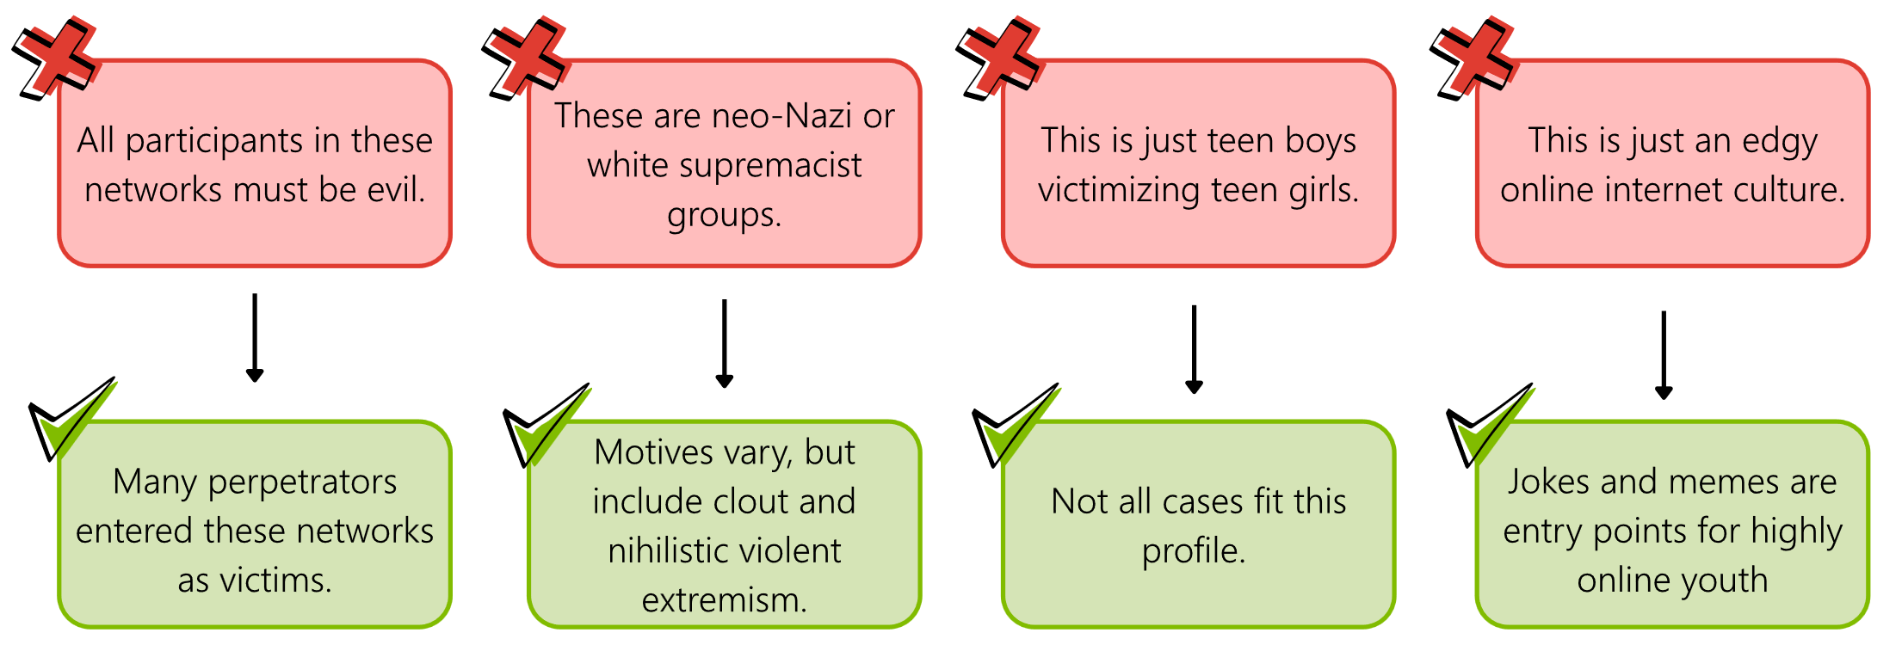
Common misconceptions
Source: The DVERT Center, www.dvert.org.
Notes:
First, there is a misconception that all participants in The Com must be evil. In fact, the young people who end up in these networks are often vulnerable in ways that leave them susceptible to harmful influences.
Many perpetrators entered these networks as victims and began to victimize new targets to comply with demands from their abusers (e.g., the victim-to-perpetrator cycle).
Second, some also believe that these are neo-Nazi or white supremacist groups. The reality is that the participants in these networks have widely varying motivations, to include pursuit of internet clout or fame or the desire to cause harm for its own sake or to destroy modern society.
Some networks specifically target young people of color and LGBTQIA+ youth for grooming and victimization.
That said, a subset of Com networks do endorse Neo-Nazi ideas and practices- especially those influenced by the Order of Nine Angles (O9A), which is a set of practices and beliefs centered around nihilistic and fascist satanism. Its adherents promote ritualistic violence against people and animals.
The third misconception is that this is just teen boys victimizing teen girls. While known perpetrators are mostly male and on average 20 years old and victims are 84 percent female and on average 15 years old, this is not universally the case.
Young boys are also vulnerable to victimization. Both victims and perpetrators are getting younger every year.
Last, some believe that The Com is just an edgy online internet culture. Com network participants use humor to hide an exploitation ecosystem dedicated to real-world harm and violence.
Jokes and memes are entry points for highly online young people who may see the shock value as alluring. Don’t let the humor obscure the culture of violence and let abuse escalate unchecked.

Slide 7



What caregivers and practitioners should watch for
Online indicators
Changes to online activity, increased time spent online, and new online friends or groups that take up a lot of time
Receiving anonymous gifts, including money, in-game currency, or other items
Interest in mass shootings, mass shooters, or other mass casualty events
Online use of suspicious slang or acronyms, such as:
  LMIRL/MIRL (“let’s meet in real life”)
  S2R (“send to receive”), WTTP (“want to trade pictures”), GNOC (“get naked on cam”), and NP4NP (“naked pic for naked pic”)
  POS (parent over shoulder”), PIR (“parent in room”), and P911 (“parent alert”)
Offline indicators
Sudden changes in behavior, appearance, and eating or sleeping habits
Isolation or withdrawal from activities or social and family relationships
Fresh cuts, scratches, bruises, or wounds, often appearing in patterns or forming words or symbols
The wearing of long sleeves or pants in hot weather
Writing or drawings in blood or what appears to be blood
Sudden suicidal ideation or threats of self-harm
Changes in the behavior or health of family pets, including fear of the young person, wounds, or suspicious deaths
Law enforcement being called to the home under false pretenses (known as swatting)
Source: The DVERT Center, www.dvert.org.
Notes:
Caregivers and practitioners should be aware of potential warning signs for involvement in the Com.
Exhibiting one or more of these behavioral indicators is cause for concern, but does not necessarily mean that a person is involved in the The Com or is planning an act of violence. It does suggest a need for supportive intervention to address potential underlying vulnerabilities.

