Slide 1
Training Snapshot: Mental Health Exploitation

Slide 2
How to use these slides
The following slides are a product of the DVERT Center, a national center of excellence that translates cutting edge research into actionable guidance for those at the front lines of preventing targeted violence and violent extremism.
The slides contain both presentation materials (the slides themselves) and information for the speaker (in the notes).
Anyone may use these slides for training or educational purposes.
Please do not modify, edit, adapt, or otherwise change the content of these slides.
If you have questions, notice an error, or have feedback, please contact us at dvert@cna.org.
The DVERT Center is supported by the National Institute of Justice, Office of Justice Programs, US Department of Justice under Award No. 15PNIJ-24-GK-00750-DOMR. The opinions, findings, and conclusions or recommendations expressed in this document are those of the authors, and do not necessarily reflect those of the Department of Justice.

Slide 3
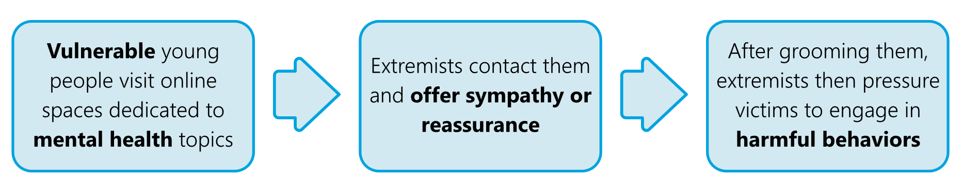
Mental health exploitation
Sextortion networks, including 764, search for vulnerable young people to exploit in online communities, such as those that encourage and support eating disorders and self-harm.
Source: The DVERT Center, www.dvert.org.
Notes:
Member of sextortion networks like 764 look on the internet for young people susceptible to influence and peer pressure. They especially target online communities that encourage and support eating disorders and self-harm. For example, they might contact young people who post in pro-anorexia or pro-cutting forums.
Young people with eating disorders, suicidal ideation, and who engage in self-harm tend to be experiencing social isolation, emotional distress, and low self-esteem. Extremists contact them, taking advantage of these vulnerabilities by first offering sympathy and reassurance then grooming their victim and pressuring them to engage in harmful behaviors.
For example: In 2025, a 14-year-old British teen visited a chat room where members were discussing self-harm. A member of the sextortion network messaged her and began grooming her—eventually learning her real name and forcing her to engage in sexual acts and self-harm under threat of blackmail.
Extremists also target vulnerable youth in positive online support communities that encourage treatment and recovery. For example, a 13-year-old boy experiencing isolation and depression posted to a mental health-related Discord server seeking friends. He ended up in a live chat where participants encouraged him to kill himself with increasing intensity and pressure until he died by suicide less than a month after first contact.

Slide 4
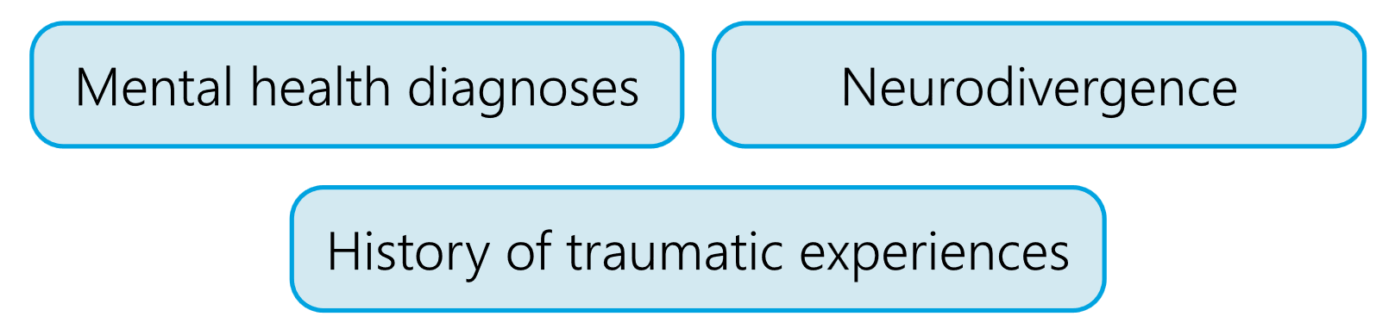
False stereotypes about radicalization
Extremists may also target teens with:
Due to a false stereotype that young people with these conditions are easier to radicalize or convince to engage in terrorism
Source: The DVERT Center, www.dvert.org.
Notes:
More broadly, extremists may also target teens with mental health diagnoses, neurodivergence, or a history of traumatic experiences.
This is due to a false stereotype that young people with these conditions are more willing or more easily pressured to commit violent acts.
Extremists are often explicit about this targeted recruitment. They use the term “weaponized autism” to glorify and demean people with autism who they perceive as programmable robots ripe for manipulation
They are often skilled at identify those vulnerable due to traumatic or adverse experiences and offering them “empowerment through violence” (often this is the only support these individuals get)

Slide 5



What caregivers and practitioners should watch for
Online indicators
Participating in online communities that encourage or support harmful behaviors
Changes to online activity, including increased time spent online
Migration to fringe or unmoderated spaces
Receiving anonymous gifts (e.g., money, in-game currency)
Online use of suspicious slang or acronyms, including:
  o “LMIRL/MIRL” (“Let’s Meet In Real Life”)
  o “S2R” (“send to receive”), “WTTP” (“want to trade pictures?”), “GNOC” (“get naked on cam”), and “NP4NP” (“naked pic for naked pic”)
  o “POS” (“parent over shoulder”), “PIR” (“parent in room”), and “P911” (“parent alert”)
Offline indicators
Sudden or significant changes in behavior, appearance, and sleeping or eating habits
Development of new, radical beliefs or extreme habits
Isolation or withdrawal from activities or social and family relationships
Fresh cuts, scratches, bruises, burns, or wounds, often appearing in patterns or forming words or symbols
Writings or drawings in blood or what appears to be blood
Sudden or increasing severity of mental health concerns, including eating disorder behaviors, suicidal ideation, or threats of self-harm
Source: The DVERT Center, www.dvert.org.
Notes:
Caregivers and practitioners should be aware of potential warning signs for involvement in exploitative mental health-related online communities.
Exhibiting one or more of these behavioral indicators is cause for concern, but does not necessarily mean that a person is involved in these spaces or is planning an act of violence. It does suggest a need for supportive intervention to address potential underlying vulnerabilities.

