Slide 1
Training Snapshot: Gore Content

Slide 2
How to use these slides
The following slides are a product of the DVERT Center, a national center of excellence that translates cutting edge research into actionable guidance for those at the front lines of preventing targeted violence and violent extremism.
The slides contain both presentation materials (the slides themselves) and information for the speaker (in the notes).
Anyone may use these slides for training or educational purposes.
Please do not modify, edit, adapt, or otherwise change the content of these slides.
If you have questions, notice an error, or have feedback, please contact us at dvert@cna.org.
The DVERT Center is supported by the National Institute of Justice, Office of Justice Programs, US Department of Justice under Award No. 15PNIJ-24-GK-00750-DOMR. The opinions, findings, and conclusions or recommendations expressed in this document are those of the authors, and do not necessarily reflect those of the Department of Justice.

Slide 3
Gore Content
Graphic, disturbing, or violent images or videos showing serious injury, death, or other bodily harm
Gore content can take many forms:
Consumption of gore content becomes concerning when done repeatedly outside the context of news, fictional entertainment, or historical documentation.
Videos or livestreams of mass casualty events
Terrorist-produced execution footage
Graphic war images
Violence against women
Extreme pornography involving visible harm or coercion
Source: The DVERT Center, www.dvert.org.
Notes:
Gore content is graphic, disturbing, or violent images or videos showing serious injury, death, or other bodily harm.
It can take many forms, including:
Videos or livestreams of mass casualty events
Terrorist-produced execution footage
Graphic war images
Content showing violence against women
Extreme pornography involving visible harm or coercion
Young people can encounter violent content in many ways, such as during breaking news coverage, in historical documentation, or in fictional entertainment.
Viewing high volumes of graphic, real-world violence outside of these contexts is concerning.

Slide 4
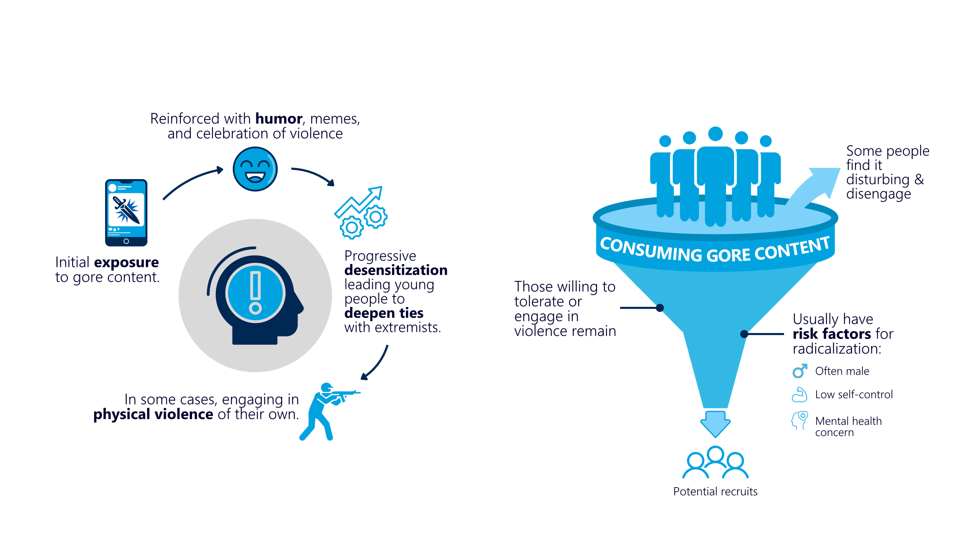


How do extremists use gore content?
DESENSITIZATION TO EXTREME VIOLENCE
SOCIAL FILTERING & RECRUITMENT
Source: The DVERT Center, www.dvert.org.
Notes:
Extremists seeking to incite violence and recruit people to their cause use gore content as a tool.
Gore content primarily serves two functions: to desensitize young people to extreme violence and to filter out those who aren’t willing to tolerate or engage in violence.
Let’s first talk about how extremists use gore content to desensitize new recruits.
After initial exposure to gore content, extremists may normalize it with humor, memes, and celebration of violence.
Over time, repeated exposure to graphic violent content can make it feel less shocking and more ordinary. Eventually, the idea of engaging in violence isn’t such a big deal anymore. As a result, desensitized people may deepen ties with extremists and in some cases, engage in physical violence of their own.
Gore content also acts as a social filter.
Young people who encounter gore content and find it disturbing will disengage. But others who are willing to tolerate or possibly engage in violence continue watching. These individuals tend to have pre-existing risk factors for radicalization, including being male, having low self-control, or having some kind of mental health concern or condition.
Extremists will target these candidates for recruitment with validation—attention, praise, and offers of community or identity.
At the end of the filtering process, extremists have a sample of people with the right characteristics for recruitment who feel bonded to the extremists through a shared interest in extreme violence.

Slide 5














Where do young people find gore content?
Unmoderated Private Spaces
Mainstream Platforms
Private Discord Servers
Telegram
Discord
Instagram
Snapchat
X (Twitter)
Gore websites
Kik
Minecraft
YouTube
Roblox
TikTok
Source: The DVERT Center, www.dvert.org.
Notes:
Young people may encounter gore content on mainstream social media or gaming platforms such as TikTok, Roblox, X (Twitter), Minecraft, and YouTube. Gore content may not be removed from these sites until a large number of viewers have seen or downloaded it.
They might also find it through unrelated internet searches for music and horror stories or have gore content sent to them by friends or online acquaintances.
There are two other spaces that often house gore content: gore websites and extremist online spaces.
Gore websites host graphic violent content, mostly for the audience’s shock or curiosity. They’re not explicitly extremist, but are frequented by extremists, who monitor these sites for individuals who show high tolerance for and interest in gore. They invite these users to private extremist spaces.
Extremist online spaces are primarily used to recruit, radicalize, and build extremist community. They are hosted on message forums, static websites, and private social media channels or servers on Telegram and Discord. Gore content appears in these spaces alongside ideological slogans, symbols, music, or text that tie the violence into the beliefs of the extremist network.

Slide 6



What caregivers and practitioners should watch for
Online indicators
Repeated sharing of graphic violence
Humor or praise directed at mass casualty events
Increased time spent online
Migration to fringe or unmoderated online spaces
Offline indicators
Sudden onset of mental health concerns or increased severity of existing conditions, including suicidal ideation or self-harm
Social withdrawal or isolation
The development of new radical beliefs or extreme habits
A growing fixation on violence or perpetrators of violence
Use of language and symbols that push an “in-group” ideology
Source: The DVERT Center, www.dvert.org.
Notes:
Caregivers and practitioners should be aware of potential warning signs for repeated consumption of gore content, especially among young people.
Children and adolescents lack fully developed critical thinking skills and are more at risk for peer pressure and influence. They may not be able to recognize manipulation or coded extremist language or might be more likely to accept claims like “it’s just a joke.”
Exhibiting one or more of these behavioral indicators is cause for concern but does not necessarily mean that a person is an extremist or is engaging in illegal activity. It does suggest a need for supportive intervention to address potential underlying vulnerabilities.

